Slide 1
Project Update

Slide 2
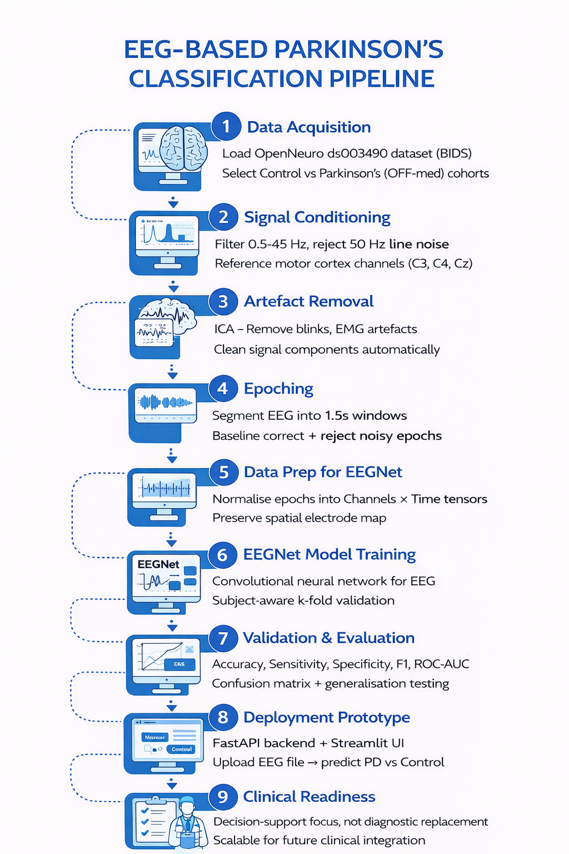

Slide 3
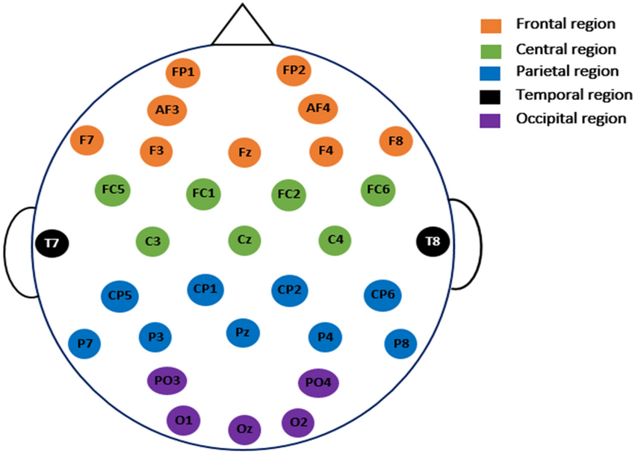
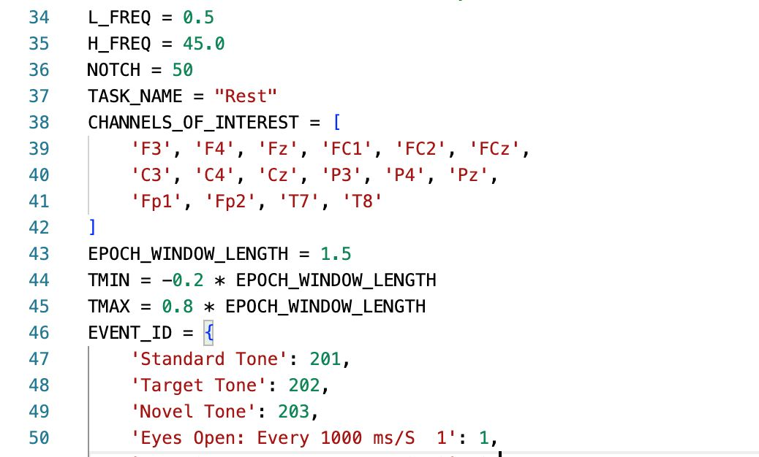
Work Completed So Far (Progress)
EEG signals loaded using MNE-BIDS framework
Channel reduction to clinically relevant motor-cortex regions
Filtering applied:
Bandpass: 0.5–45 Hz
Notch: 50 Hz (line noise removal)
Montage standardisation

Slide 4
Signal Processing Methods
1. Physiological Noise Removal
ICA (Independent Component Analysis)
Removes:
Eye blinks
Muscle activity
Cardiac artefacts
2. Epoching Strategy
Segment signals into 1.5-second overlapping windows
20% overlap improves:
Temporal sensitivity
Dataset size
Model stability
3. Baseline Correction Normalises each trial to reduce drift.

Slide 5
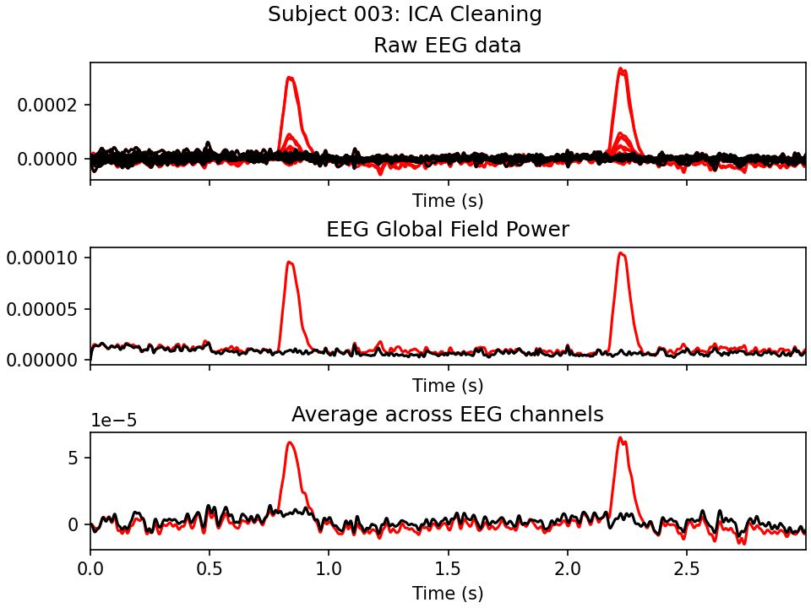

Slide 6
Feature Engineering
Time domain features
Per channel statistical moments: std, mean, skew, kurtosis
Frequency domain features
We used PSD to compute band powers
Delta (0.5–4 Hz) → cortical slowing
Theta (4–8 Hz) → cognitive control changes
Alpha (8–13 Hz) → motor inhibition disruption
Beta (13–30 Hz) → key Parkinson’s biomarker

Slide 7
Models & Algorithms
Chosen Model: EEGNet
Why EEGNet:
Designed specifically for EEG
Lightweight architecture → lower overfitting risk
Performs well for clinical EEG tasks
What EEGNet learns
Temporal filters → frequency-related EEG patterns (e.g., beta, alpha)
Depthwise spatial filters → how channels interact (motor cortex patterns)
Separable convolutions → efficient feature learning

Slide 8
Testing & Validation
We will split the data into training and testing and after training, we will do cross validation.

Slide 9
Evaluation & Accuracy
Accuracy
Precision
Recall
F1-Score
ROC–AUC
Confusion Matrix

Slide 10
Operational Deployment Plan (Streamlit + FastAPI)
Deployment Approach: Web-based clinical prototype using a separated frontend and backend architecture.
Streamlit (Frontend UI): provides an interactive web page for users to upload EEG recordings, adjust analysis settings, and view results.
FastAPI (Backend Service): hosts the EEG processing and inference pipeline, running preprocessing (MNE) and EEGNet predictions.
Model Inference Flow: Upload EEG → preprocessing & epoching → EEGNet prediction → probability + label returned → results displayed in UI.
Output Display: predicted class (Parkinson’s vs Control), confidence score, and an optional short interpretation message.

Slide 11
